Slide 1
GIS and Spatial Analytics
Lecture 6

Slide 2
What Will We Cover Today?
Buffers Recap!
Points, Near (Closest) and Distances
Summary Statistics
Geocoding Addresses

Slide 3
Spatial Overlays
Spatially combine two layers to:
Generate a new output data layer
Assign attributes of one data layer to another
Usually one of the data layers will be polygons
A point-in-polygon overlay is typical

Slide 4
Proximity Tools
Buffer
Multiple Ring Buffer
Near
Point Distance

Slide 5
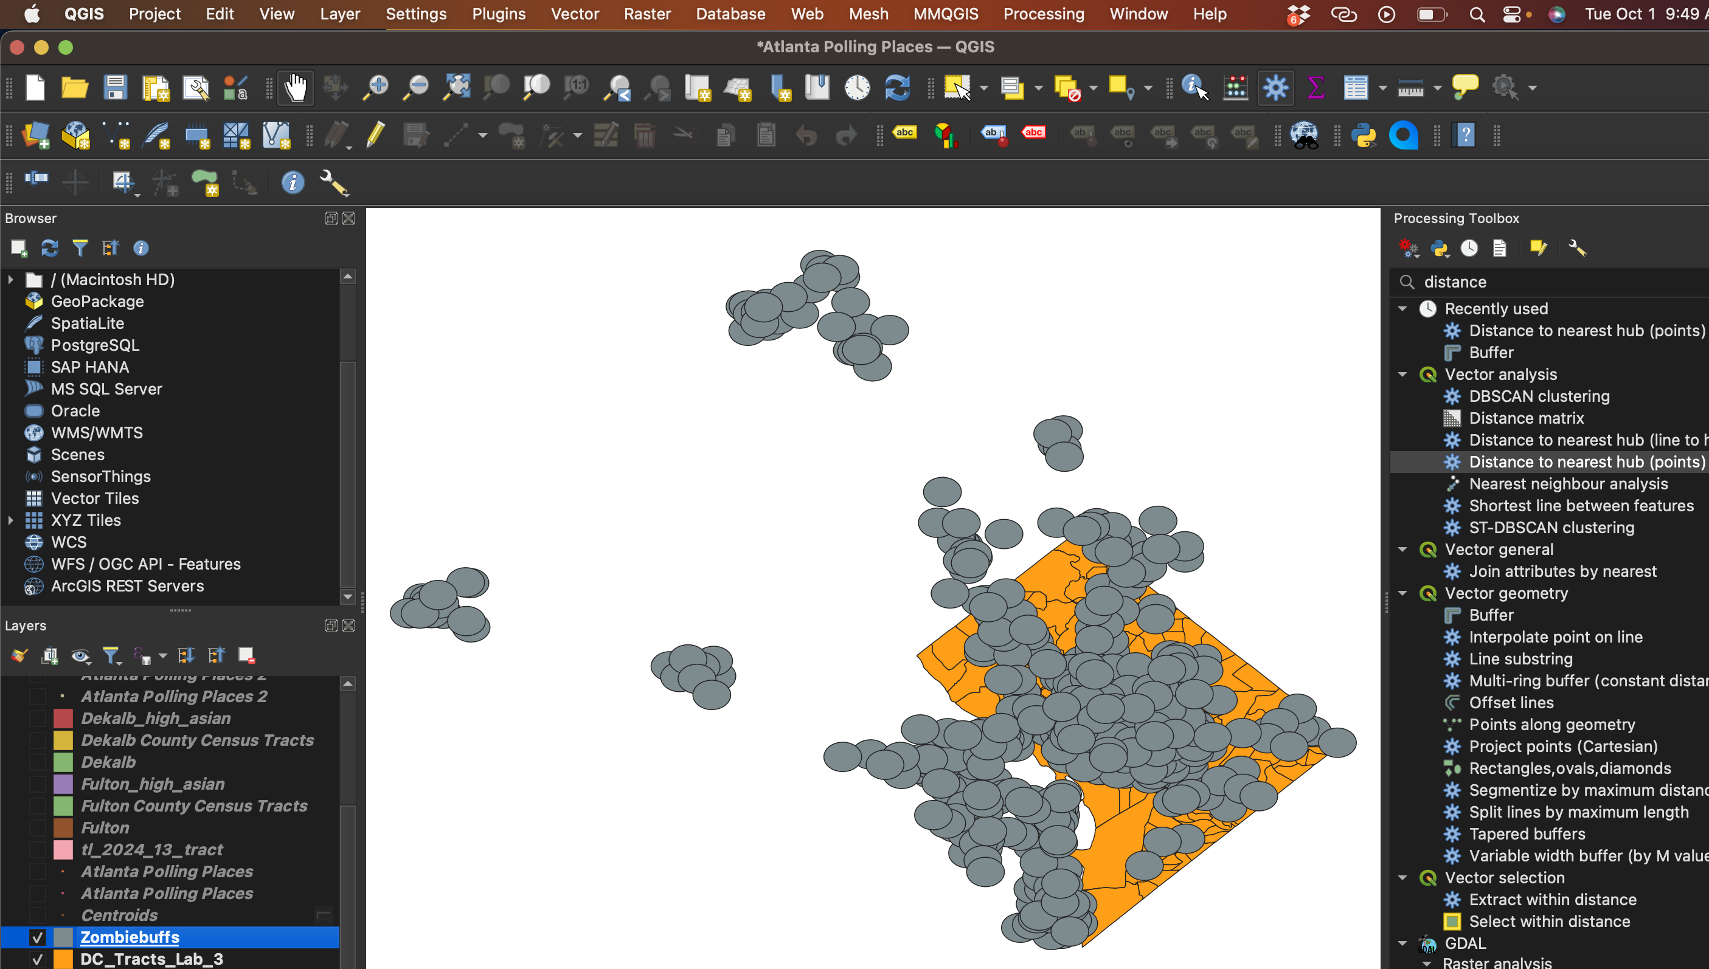

Slide 6
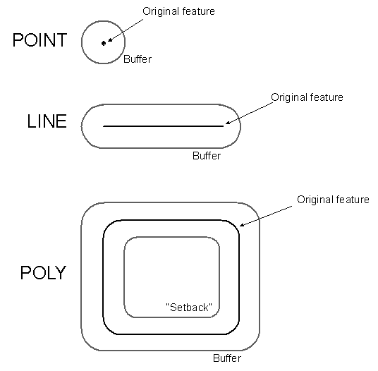
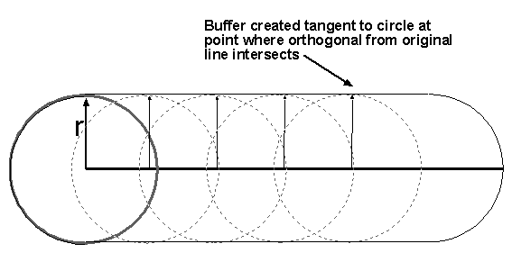
Buffers for Lines and Polygons
Move circle of specified radius along line
(or lines forming polygon)

Slide 7
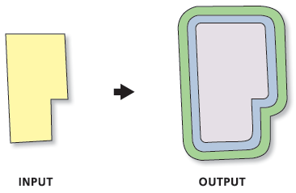
Multiple Ring Buffer
Creates a new feature class of buffer features using a set of buffer distances. The new features may be dissolved using the distance values or as a set of individual features.

Slide 8
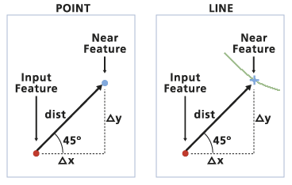
Near
Computes the distance from each point in a feature class to the nearest line or point in another feature class.

Slide 9
GIS is not perfect
A GIS cannot perfectly represent the world for many reasons, including:
The world is too complex and detailed.
We make decisions (how to categorize data, how to define zones or districts) that are not always fully informed or justified.
It is impossible to make a perfect representation of the world, so uncertainty is inevitable
Uncertainty degrades the quality of a spatial representation

Slide 10
A Conceptual View of Uncertainty
Real World
Conception
Measurement &
Representation
Data conversion and Analysis
error propagation
Result
Notes:
U1:
1. Spatial uncertainty. firstly, Tobler’s law: spatial autocorrelation, secondly, natural units of analysis: what is the measurement unit for a soil profile, how might we delimit an environmental impact of spillage from an oil tanker?
(In nature, ecological phenomena or discrete
features either influence neighbors, are influenced by neighbors, or both. The level of
neighbor influence may vary with distance and other factors, making the autocorrelation
function non-linear. In general, the closer the neighbors, the greater the level of
correlation, which distorts statistical tests of significance in analyses such as correlation,
regression, or analysis of variance (Cliff and Ord 1981).
)
2. Vagueness. can exist both in the positions of the boundaries of a zone and its attributes. how many oak trees in a forested zone can label as oak woodland? how far from ABQ to Socorro
3. Ambiguity. many objects are assigned different labels by different national or cultural groups. this is inherently ambiguous. second, imperfect indicators of phenomena cause ambiguous. For example, detail household income figures, provide direct indicator of demand for goods and services; rates of multiple car ownership might provide indirect indicator for household income data.
U2:
1. Measurement & Representation
objects and fields: raster and vector are characterized by different uncertainties: vector requires a priori conceptualization of the nature and extent of geographic individuals and the ways in which they nest together into higher-order zones. raster defines square or rectangle cells, with boundaries that bear no relationship at all to natural features. furthermore, the measurement process can actually introduce uncertainty.
2. error and accuracy
Digitizing error, GPS accuracy
U3:

Slide 11
Response to Uncertainty
Acknowledge it!
Use metadata to document the uncertainty
Analysis can sometimes identify the impact of input uncertainty on output
Use multiple sources of data
Be honest and appropriately modest in reporting the results of analysis

Slide 12
Common Errors
One-to-many, vs. one-to-one joins
Intend a one-to-one join
Result is a one-to-many join
Be careful with islands
Every polygon in a shapefile gets a record, even if it belongs to the same unit

Slide 13
Single Parts vs. Multiple Parts
If there are islands, a unit (state, province) must be drawn as a multi-part feature in the shapefile (the spatial data)
Then there will be only one row in the attribute table
If each island is drawn as a separate feature, there will be multiple rows in the attribute table

Slide 14
Multi-Part vs. Single-Part
We join the state population figures to
a file of states, here to a multi-part
shapefile
Note the population
sum is wrong here

Slide 15
Merge and Single-to-Multi-part Commands
Merge – takes single-part features and merges to multi-part
Explode – goes from multi- to single, making the parts of multi-part features independent
These work on all features in a layer rather than just selected features when used via the geoprocessing tools in QGIS

Slide 16
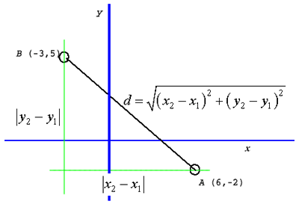
Spatial is special: 3 critical concepts
Distance/Proximity
Adjacency
or neighborhood
Interaction

Slide 17
Fundamental Spatial Concepts
Distance
The magnitude of spatial separation
Euclidean (straight line) distance often only an approximation
Adjacency or neighborhood
Nominal or binary (0,1) equivalent of distance
Levels of adjacency exist: 1st, 2nd, 3rd nearest neighbor, etc..
Interaction
The strength of the relationship between entities
An inverse function of distance

Slide 18
Statistics Tools
Frequency
Summary Statistics

Slide 19
Frequency
Produces a list of the unique code occurrences and their frequency in an output table for a specified set of fields from an input feature class or table.
Optionally, summary items may be totaled for each unique code combination—for example, the total area for unique combinations of zoning and land use.

Slide 20
Summary Statistics
Generates summary statistics for fields from an input table or feature class and saves them in an output table.
This tool contains the following statistics types: sum, mean, minimum, maximum, standard deviation, range, first value, and last value.

Slide 21
The Process of Geocoding:
Standardizing the address
Searching for potential candidates
Scoring each candidate
Matching address to best candidate

Slide 22
Standardizing the Address
During this step the address is broken into components
For example: street number, street name, street type and street direction

Slide 23
Matching Address to Best Candidate
The geocoding service looks for the potential candidate with the highest score
If the score exceeds the minimum match score setting, then the service matches the address with that candidate

Slide 24
Geocoding Process Settings
Spelling Sensitivity
Minimum Candidate Score
Minimum Match Score

Slide 25

MMQGIS PLUGIN

Slide 26
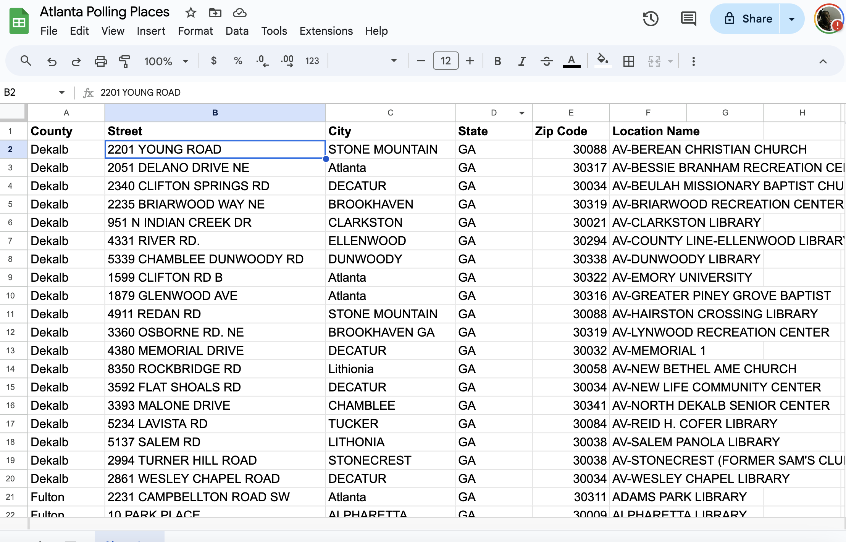
ADDRESSES

Slide 27
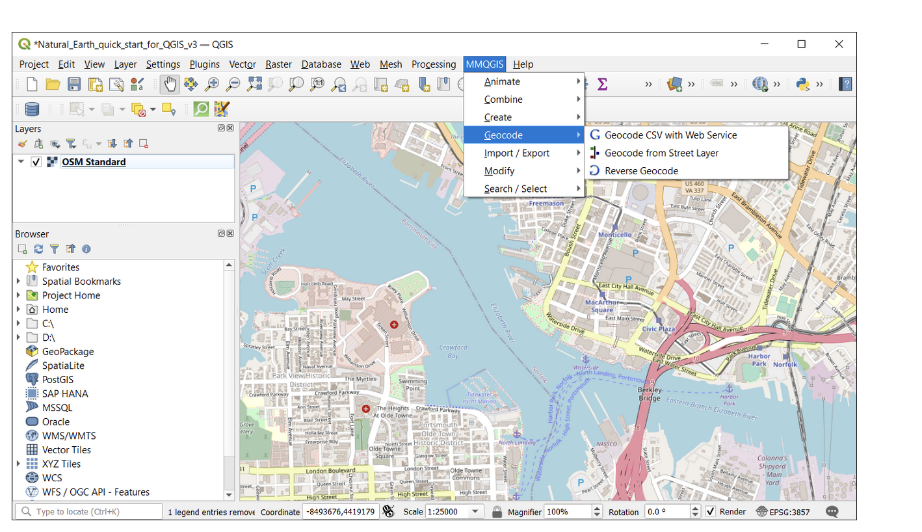

Slide 28


Slide 29
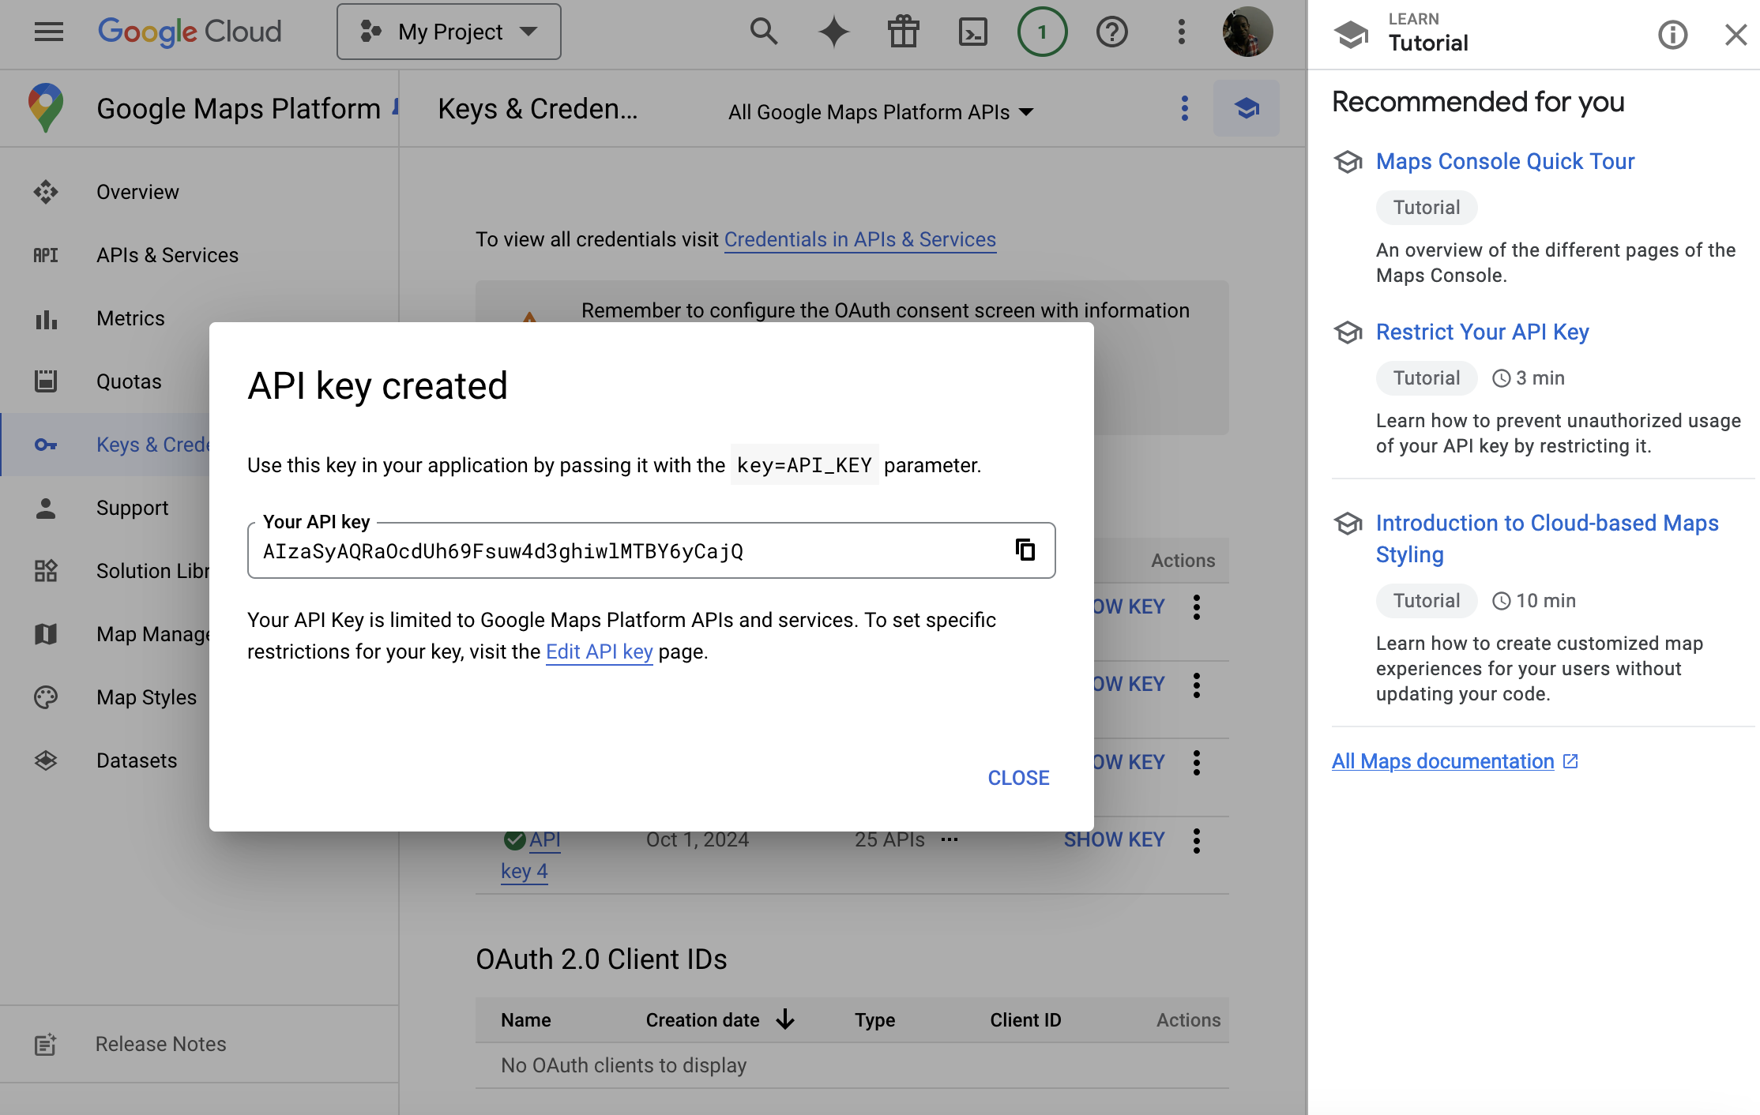

Slide 30
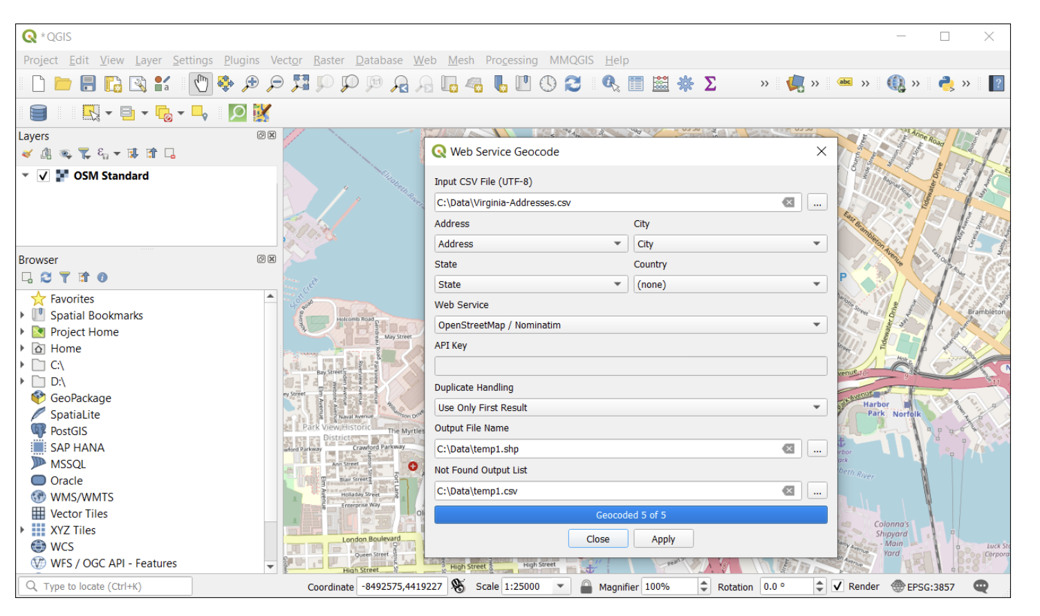

Slide 31
